Slide 1
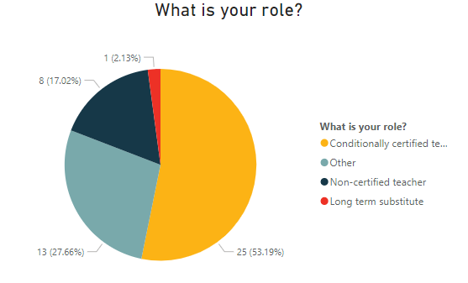
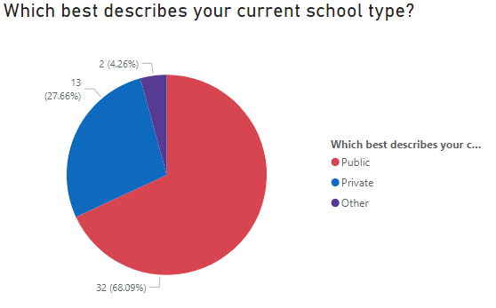
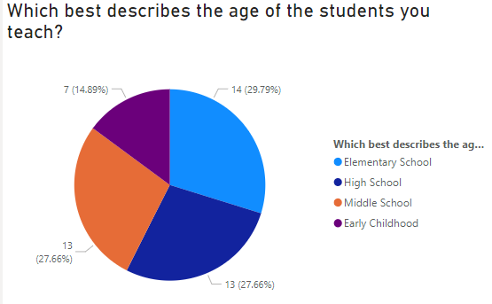
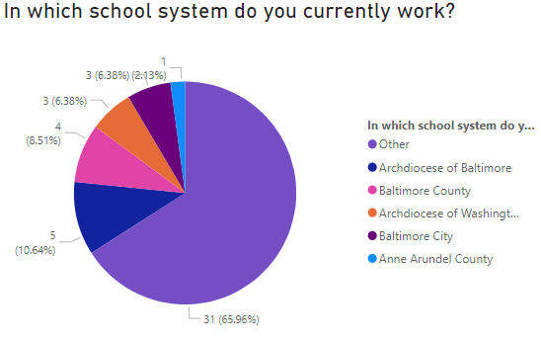
Employed Intern Survey Spring 2023: Participant Data
In total, the survey had 47 respondents.
Over half of the respondents indicated that they were employed as conditionally certified teachers.
68% of respondents worked in a public school, more than twice as many as those employed in private schools.
Roughly the same number of respondents taught elementary, middle, and high school students; approximately half as many taught early childhood education.
Two-thirds of respondents indicated that they worked outside of NDMU’s partnered school districts, with zero respondents present in Howard or Harford County.

Slide 2
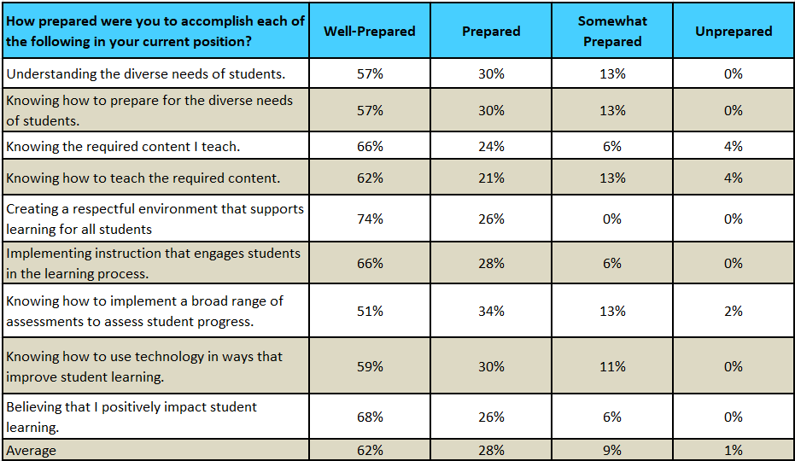
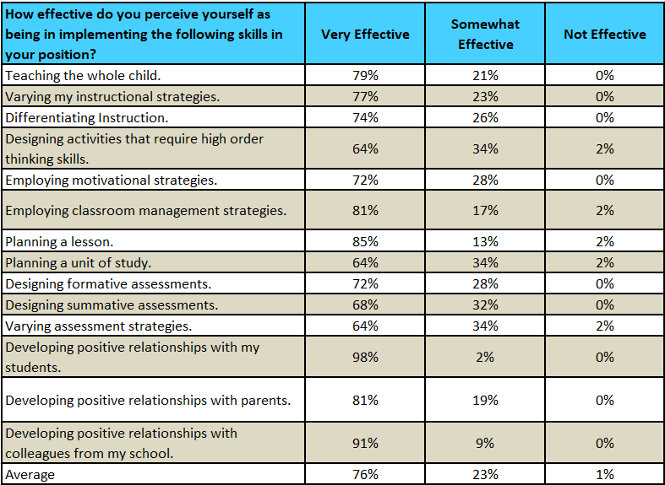
Employed Intern Survey Spring 2023: Overall Intern Preparedness
90% of respondents on average indicated that they felt at least prepared to accomplish positive goals in their classroom, with nearly two-thirds feeling well-prepared and only 1% feeling unprepared. Respondents felt the most prepared for creating a respectful environment that supports learning for all students and the least prepared for knowing how to implement a broad range of assessments to assess student progress.
76% of respondents on average felt that they were very effective in the classroom, with 99% feeling at least somewhat effective. Respondents felt most effective at having positive relationships with students, parents, and colleagues, and least effective at varying assessment strategies and planning a unit of study.

Slide 3
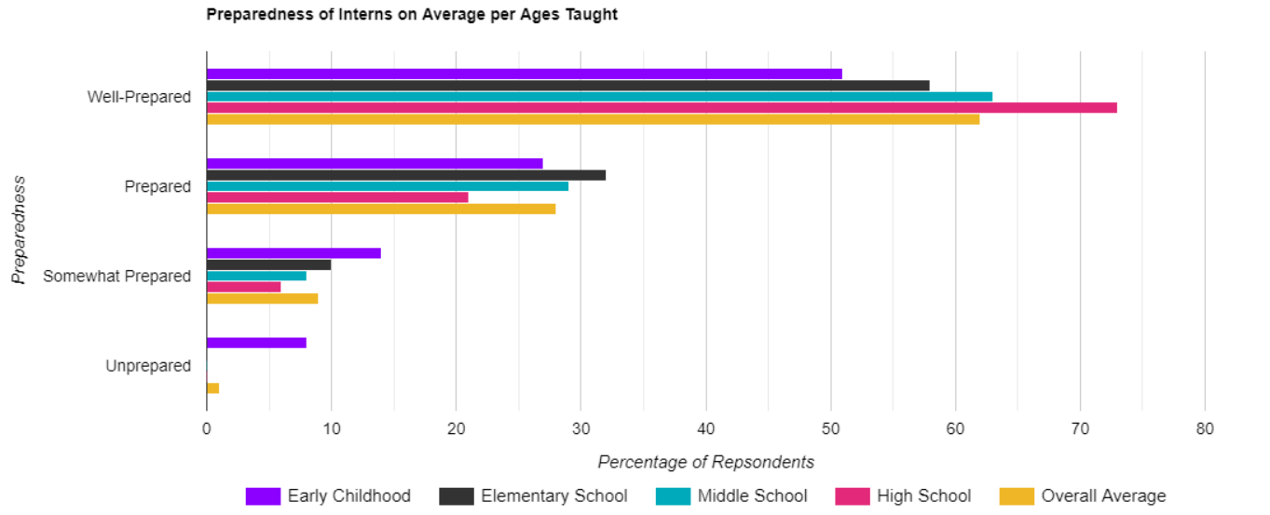
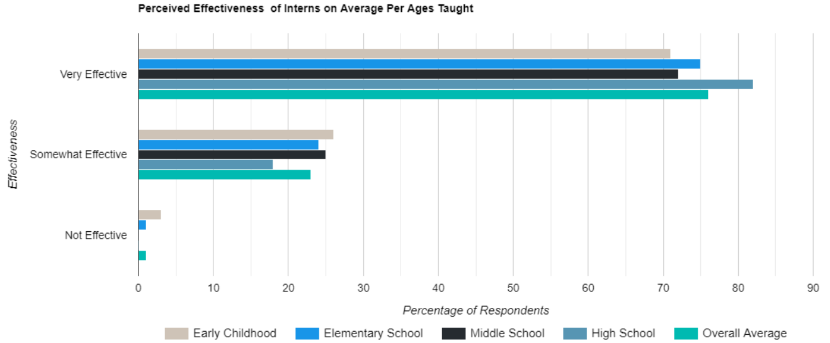
Employed Intern Survey Spring 2023: Average Preparedness by Ages Taught
Respondents teaching in early childhood education felt significantly less prepared than those teaching in other age groups, while those teaching in high school scored well above the average.
Elementary, middle, and high school respondents’ areas of most and least preparedness lined up with the overall average, while early childhood education respondents instead felt the least prepared for knowing the required content and knowing how to teach the required content.
Those teaching in early childhood education also perceived themselves as less effective on average than any other group, while high school respondents once again scored higher than average for effectiveness.
The areas of most and least effectiveness for each age group taught mirrored the overall average for all four groups.

