Slide 1
Notre Dame of Maryland University 2017-2018 Student Health Insurance Plan

Slide 2
Highlights of Coverage
No Overall Maximum Dollar Limit (Per Insured Person, Per Policy Year)
Insurance Company
United Healthcare
Deductible
Preferred Provider - $250
Out of Network - $600
Coinsurance
Preferred Provider – 80%
Out of Network – 60%
Out of Pocket Maximum
Preferred Provider - $6,850
Out of Network - $15,000
The Health Plan is provided by United Healthcare. If you have additional questions or would like to download a copy of the brochure, please feel free to visit www.firststudent.com and select Notre Dame of Maryland University from the “Find Your School” drop-down box.

Slide 3
Frequently Asked Questions
Definitions
Q: What is a deductible?
A: A deductible is the amount you owe for services your health insurance plan covers before the plan begins to pay. For example, if your deductible is $250, your plan won't pay anything until you've met your $250 deductible for covered health care services subject to that deductible. The deductible may not apply to all services.
Q: What does "copayment" and "coinsurance" mean?
A: A copayment is a specific out-of-pocket dollar amount you pay to a provider at the time of service. Coinsurance is a percentage of covered expenses you pay. For instance, a plan could be set up so the insurer pays 80% of a bill, and you pay the other 20%.
Q: What does "usual and customary charges" mean?
A: Those words (also sometimes called "usual, customary and reasonable") refer to the charges and costs typical or standard for your region. Let's say the usual, customary, and reasonable fee (based on an accurate study of doctors' charges) for an anesthesiologist is $500. If he charges you $600, your insurance will pay its percentage of the $500. You'll pay anything above that percentage of the $500, plus your deductible.
Q: What does in-network and out-of-network mean?
A: An in-network provider, referred to as a preferred provider with UHCSR, is a health care provider who has contracted with UHCSR to provide services to insureds for specific negotiated rates. An out-of-network provider is one not contracted with UHCSR. Typically, the deductible and coinsurance are both higher if you go to an out-of-network provider. You'll save money by opting to be seen by a preferred provider.
Q: What is a Preferred Provider Organization (PPO)?
A: A Preferred Provider Organization is an entity where providers are under contract to an insurance company or health plan to provide care at a discounted or negotiated rate. Typically, you can see any doctor in the PPO network without requiring special approval, and you usually don't need to choose a primary care physician. Most PPOs also allow you to seek care outside of the PPO network; however, the benefits are usually reduced and the insured has a greater out-of-pocket expense.

Slide 4
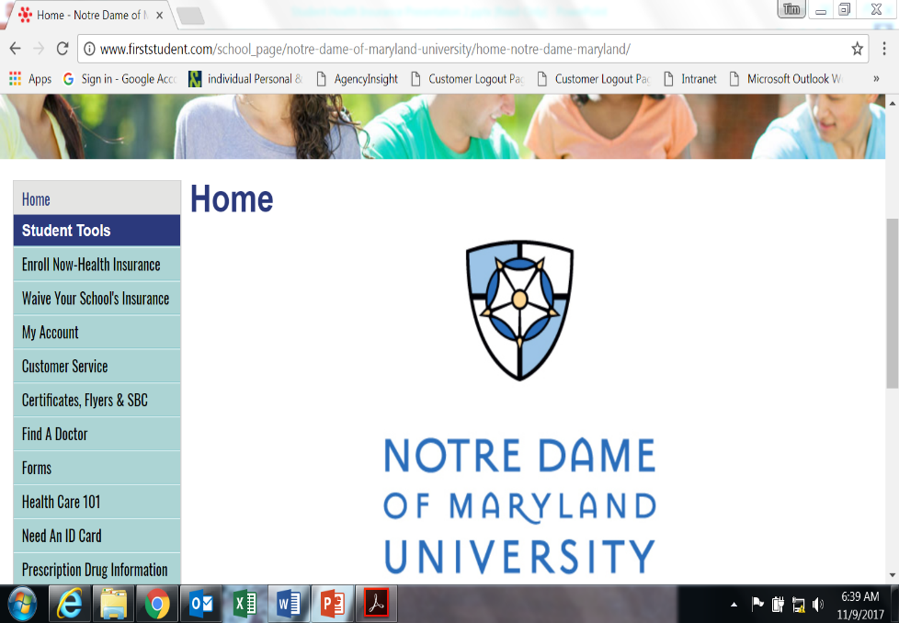
Resources
www.firststudent.com
Visit www.firststudent.com and select Notre Dame of Maryland University from the “Find Your School” drop-down box
Summary of Benefits
Find a Doctor, Hospital or Lab
Prescription Drug Information
Need an Id Card
File a Medical/Prescription Claim
Check Claim Status
Dental, Vision and Other Discount Services
Health Advocate
Call a Nurse
Travel Assistance, Evacuation & Repatriation

Slide 5
Resources
Need an ID Card?
WWW.FIRSTSTUDENT.COM
Gives you instant access to a temporary ID card and you have the opportunity to request
a new permanent ID card from the comfort of your own computer chair
Create an Account
If you would like to request a permanent id card or print a temporary card you will need to create an online account
Once you have created your account, you’ll have 24/7 access to:
Review Claims status, correspondence and Explanation of Benefits (EOB)
Request/Print an ID card
Enter accident details online
Enter additional insurance information online
You can now access your information from the UHC Mobile App. (The mobile site, my.uhcsr.com, can be accessed on the iPhone 3 and 4, HTC, Samsung, and Motorola Droid phones, and the Blackberry v6.0. Supported browsers are Firefox, Chrome, and Opera Mini. Of course, users of non-supported mobile devices and browsers can access the full MyAccount site at www.uhcsr.com. )

Slide 6
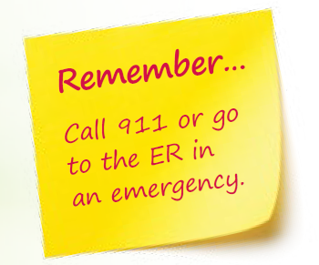
Resources
Call a Nurse
Health questions and issues can come up anytime. With NurseLine, you have unlimited access to a Registered Nurse day or night.
Experienced nurses are available 24/7 to:
Offer self-care information for non-urgent health issues.
Direct you to the appropriate care for immediate attention.
Explain health conditions and treatments.
Answer questions about symptoms or medications.
Recommend how to treat a fever in the middle of the night.
Tell you if your symptoms mean you have the flu.
Advise how to ease common problems like a sore shoulder.
Inform you of side effects of your medications.
Call anytime 24/7
1-866-799-2752

Slide 7
Resources
Health Advocate
Health Advocate is an added bonus when you enroll in a UnitedHealthcare student medical plan. Your Health Advocate benefit, provided by Dickinson College, includes three important features: Healthcare Help, MedChoice Support, and Medical Bill Saver. This all-in-1 benefit is designed to help you personally navigate the healthcare maze, make better decisions about your medical care, and lower your medical bills.
Healthcare Help
Reasons to Call
Find the right doctors, hospitals,
Schedule tests, appointments,
Secure second opinions,
Untangle Claims, billing errors,
Navigate your insurance plan,
Explain conditions, treatments, and
Health you make informed decisions
Medchoice Support
How can it Help?
Step-by-step guidance for healthcare decisions, using evidence-based information, on topics from surgery to alternative treatments,
Personal assessments gauge feelings and decisions, and
Downloadable summary to share with your healthcare team.
Medical Bill Saver
How can it Help?
Negotiation can result in 25-50% savings.
Easy-to-read, personal Saving Result Statement, summarizing outcome and payment terms.
Provider sign-off on payment terms and conditions.
Help is Only a Phone Call Away! Phone Number: 1-866-799-2670 Email: answers@HealthAdvocate.com Web: HealthAdvocate.com/members

Slide 8
Resources
Travel Assistance, Evacuation & Repatriation
As a UnitedHealthcare member you are eligible for global emergency and medical assistance services provided by UnitedHealthcare Global. These benefits are available if you are traveling 100 miles or more from your permanent home, campus address, or while you are abroad. These services are accessible 24 hours a day, 365 days a year!
UnitedHealthcare Global offers the following key services:
Medical Assistance Services
Medical Evacuation & Repatriation Services
Security & Natural Disaster Evacuation Services
Worldwide Destination Intelligence
Travel Assistance Services
To learn more about this valuable benefit, review the UHCG Program Guide.
How To Use UnitedHealthcare Global Assistance Services
24 hours a day, 7 days a week, 365 days a year
If You have a medical, personal safety or travel problem, simply call Us for assistance. Our toll-free and collect-call telephone numbers are printed on Your ID card. Either call the toll-free number of the country You are in, call the Emergency Response Center collect, or email the Emergency Response Center at:
Toll-free Number: +1-800-527-0218
Call Collect: Baltimore, MD, USA +1-410-453-6330
Email: operations@unitedhealthcareglobal.com
© 2013 RCM&D. All Rights Reserved.

Slide 9
Contact Information
2017-2018 Student Health Insurance Plan
Call A Nurse: 866-799-2670 (available 24/7)
Health Advocate: 866-799-2670 (available 24/7)
Global Emergency Services: 800-527-0218 (toll-free within the US)
410-453-6330 (collect outside the US)
Claims or Replacement of Card – www.firststudent.com
Customer Service: 800-505-4160 (available 7am – 7pm cst)
Insurance Broker (RCM&D): Tim Cummons
phone: 800-346-4075 ext. 1452
email Notre.Dame@rcmd.com

